Slide 1

Convolutional Neural Networks for Facial Emotion Recognition with Image Processing
Jocelyn Tan csc481 final presentation

Slide 2


Which facial emotion is expressed in this image?
Happy: 0.9956

Slide 3

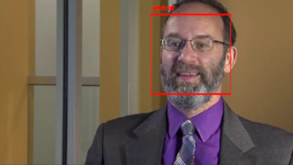
Which facial emotion is expressed in this image?
neutral: 0.493878
happy: 0.247102,
scared: 0.12921,
surprised: 0.078482,
sad: 0.023886,
angry: 0.023857,
disgust: 0.00358,

Slide 4
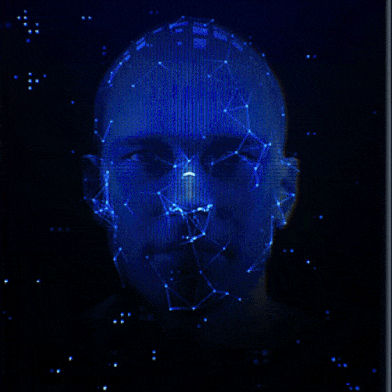

Background and Goal
Facial Expressions
Important part of communication
Convey non-verbal cues
Interpersonal relations
Application:
Natural human-machine interface
Behavioral science
Clinical practice
Goal
Understanding Convolutional Neural Network (CNN)
Comparing the influence of different processing methods on Facial Emotion Recognition

Slide 5
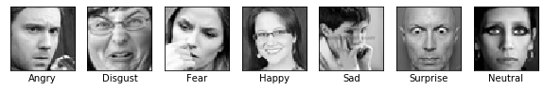
Dataset
- 35,888, 48x48 pixel gray-scale images of faces
- Obtained from Kaggle
Emotion | Angry | Disgust | Fear | Happy | Sad | Surprise | Neutral
Counts | 4953 | 547 | 5121 | 8989 | 6077 | 4002 | 6198

Slide 6
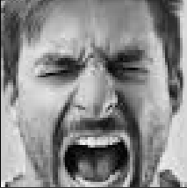
Methodology: CNN Mini Xception [1]
Residual modules[2]
Depth-wise separable convolutions[3]
4x
Conv2D
BatchNorm
Conv2D
BatchNorm
Conv2D
BatchNorm
Conv2D
Global Avg. Pooling 2D
Softmax
+
Sep-Conv2D
BatchNorm
Sep-Conv2D
BatchNorm
MaxPool 2D
60,000 parameters – 8 hours for each experiment
138,357,544 parameters for VGG16

Slide 7
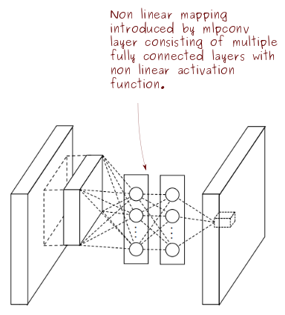
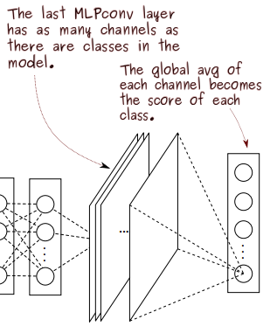
Global average pooling
Conventional neural networks
flatten their input before applying the weights
losing the spatial information
Global Average Pooling
no new parameters to train (unlike the FC layers), leading to less overfitting
sums out the spatial information, thus it is more robust to spatial translations of the input.

Slide 8


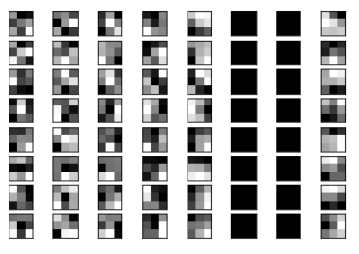
CNN Visualization – Filters and Feature maps
weights of the second 2D convolutional layer (right)
8 filters in the layer and each of the n channels of each filter
weights of the first two-dimensional convolutional layer (left)

Slide 9
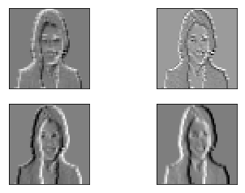
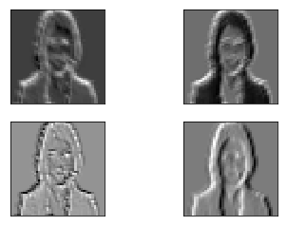
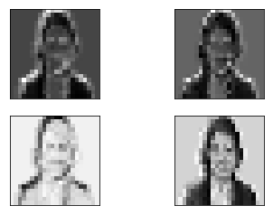

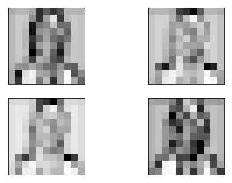
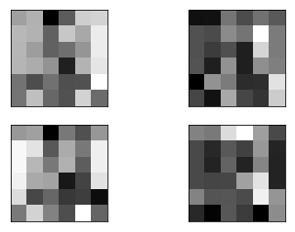
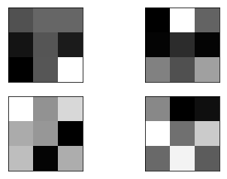
CNN Visualization – Filters and Feature maps
General expectation
the feature map closer to the input detects finer detail
the feature map close to the output capture more generalized features.

Slide 10

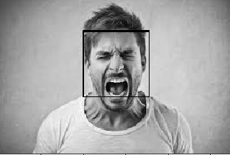




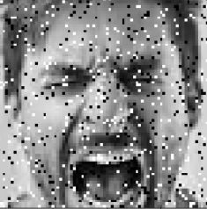
Methodology: Image processing
Face Detection
Haar Feature-based cascade classifiers
Cropping
Input: Angry man
Median Blur
Gaussian Blur
Histogram Equalization
Global Contrast Normalization
Salt & Pepper Noise

Slide 11
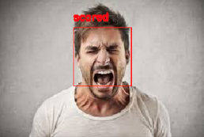
Image processing exploration
Original Test Image

Slide 12

Flowchart
Iterative Process
Data Preparation with selected Pre-processing steps
Model Training
Original
Test Image
Face Detection and Cropping
Median Filter/Gaussian Filter
Global Contrast Normalization
Histogram Equalization
Adding Noise
Model Prediction

Slide 13
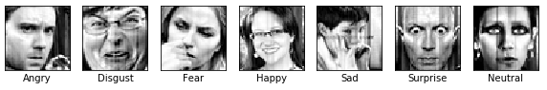
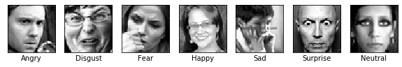
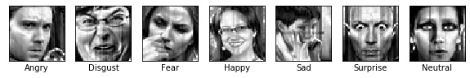
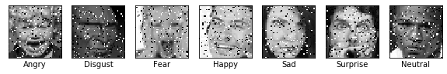
Results
GCN Only:
Model | Training Accuracy | Training Loss | Valid. Accuracy | Valid. Loss
Mini Xception | 0.6924 | 0.8272 | 0.6456 | 0.9716
+HE | 0.6803 | 0.8571 | 0.6410 | 0.9744
+ Add Noise | 0.6648 | 0.9018 | 0.6329 | 1.0007
+GCN | 0.6933 | 0.8276 | 0.6265 | 1.0299
+GCN+HE | 0.6728 | 0.8771 | 0.6240 | 1.0132
Histogram Equalization:
GCN + Histogram Equalization:
Add Salt& Pepper Noise:

Slide 14
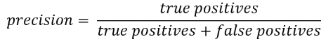
Results
Provide better precisions for:
Disgust, Angry and Neutral
(Hard cases for original model)

Slide 15

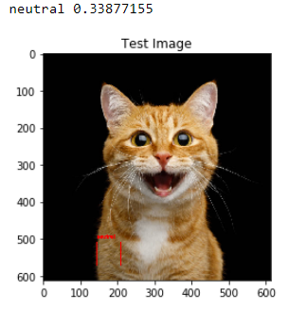
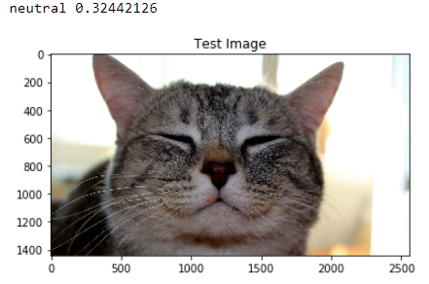
Conclusion
CNN is a black box
Image Processing improves prediction on unseen data (same species?)
Certain techniques provide better precisions for certain emotions
Image Processing might not be necessary for CNN
Image Processing should be applied with cautious and clear purpose

Slide 16
Reference
[1] O. Arriaga, M. Valdenegro-Toro, and P. G. Ploger, “Real-time Convolutional Neural Networks for emotion and gender classiﬁcation,” European Symposium on Artificial Neural Networks, Computational Intelligence and Machine Learning, p. 6, 2019.
[2] K. He, X. Zhang, S. Ren, and J. Sun, “Deep Residual Learning for Image Recognition,” 2016 IEEE Conference on Computer Vision and Pattern Recognition (CVPR), pp. 770–778, 2015.
[3] A. G. Howard et al., “MobileNets: Efficient Convolutional Neural Networks for Mobile Vision Applications,” ArXiv, vol. abs/1704.04861, 2017.
[4] “OpenCV: Cascade Classifier.” [Online]. Available: https://docs.opencv.org/3.4/db/d28/tutorial_cascade_classifier.html. [Accessed: 19-Nov-2019].
[5] P. Viola and M. J. Jones, “Robust Real-Time Face Detection,” International Journal of Computer Vision, vol. 57(2), pp. 137–154, 2004.
[6] F. Chollet, “Xception: Deep Learning with Depthwise Separable Convolutions,” 2017, pp. 1800–1807.

